Slide 1
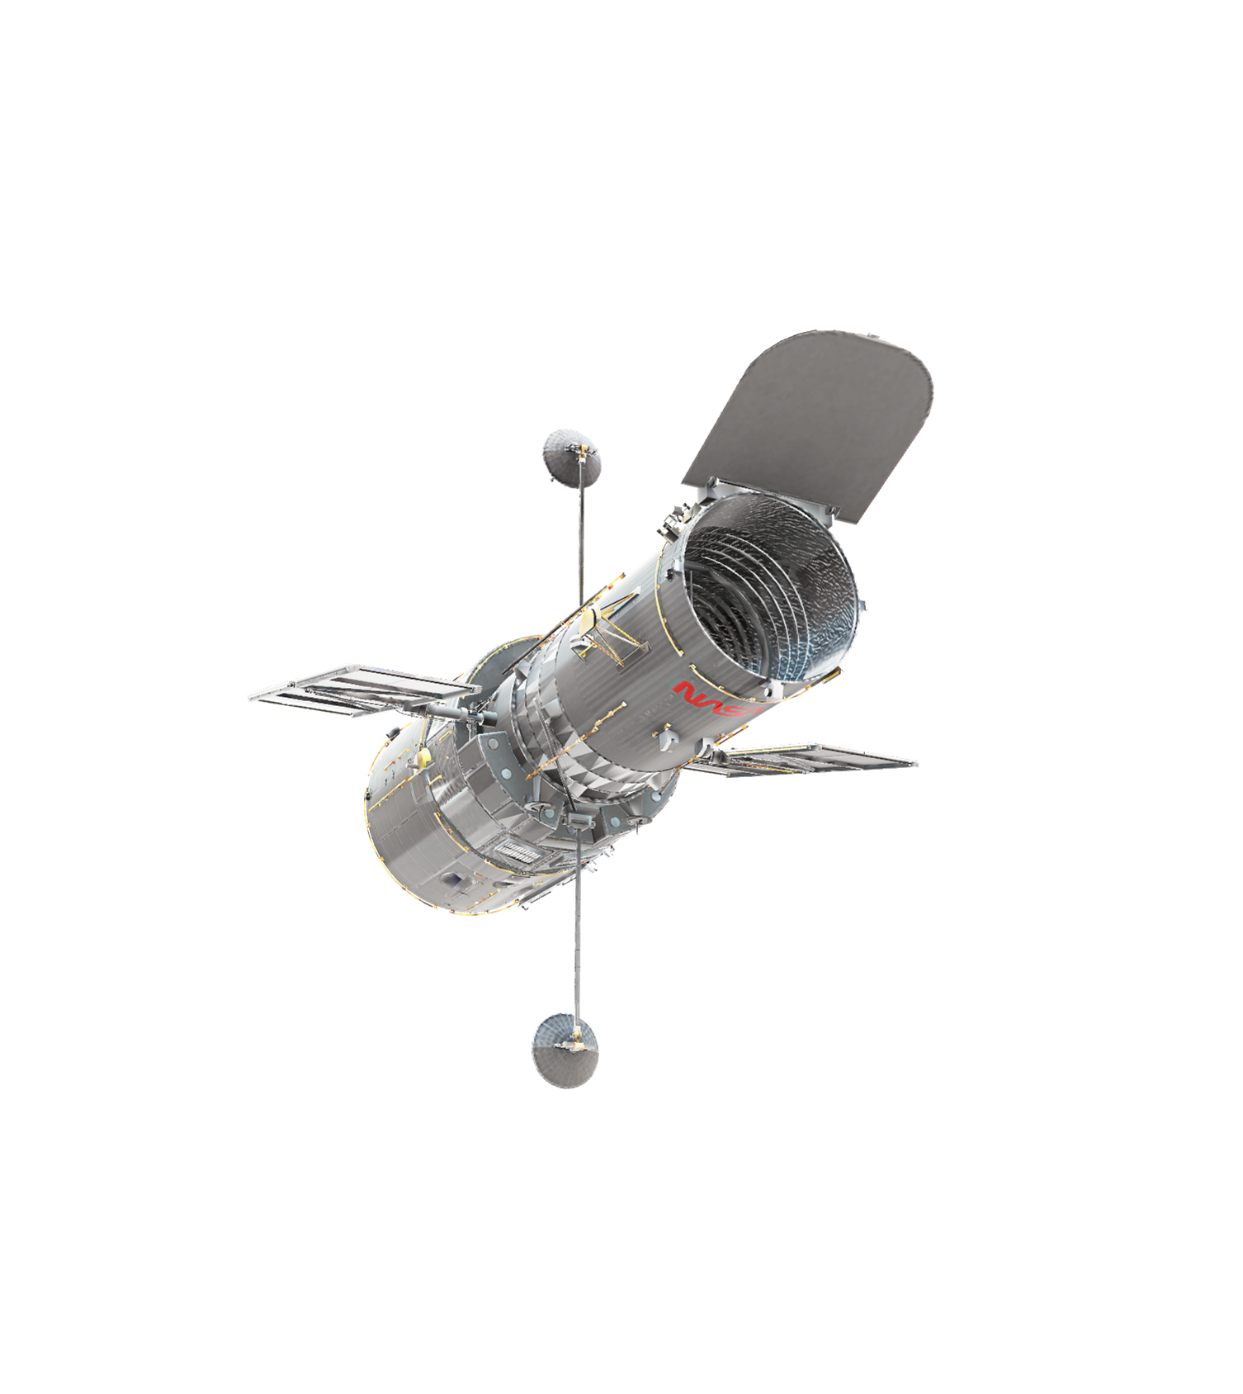
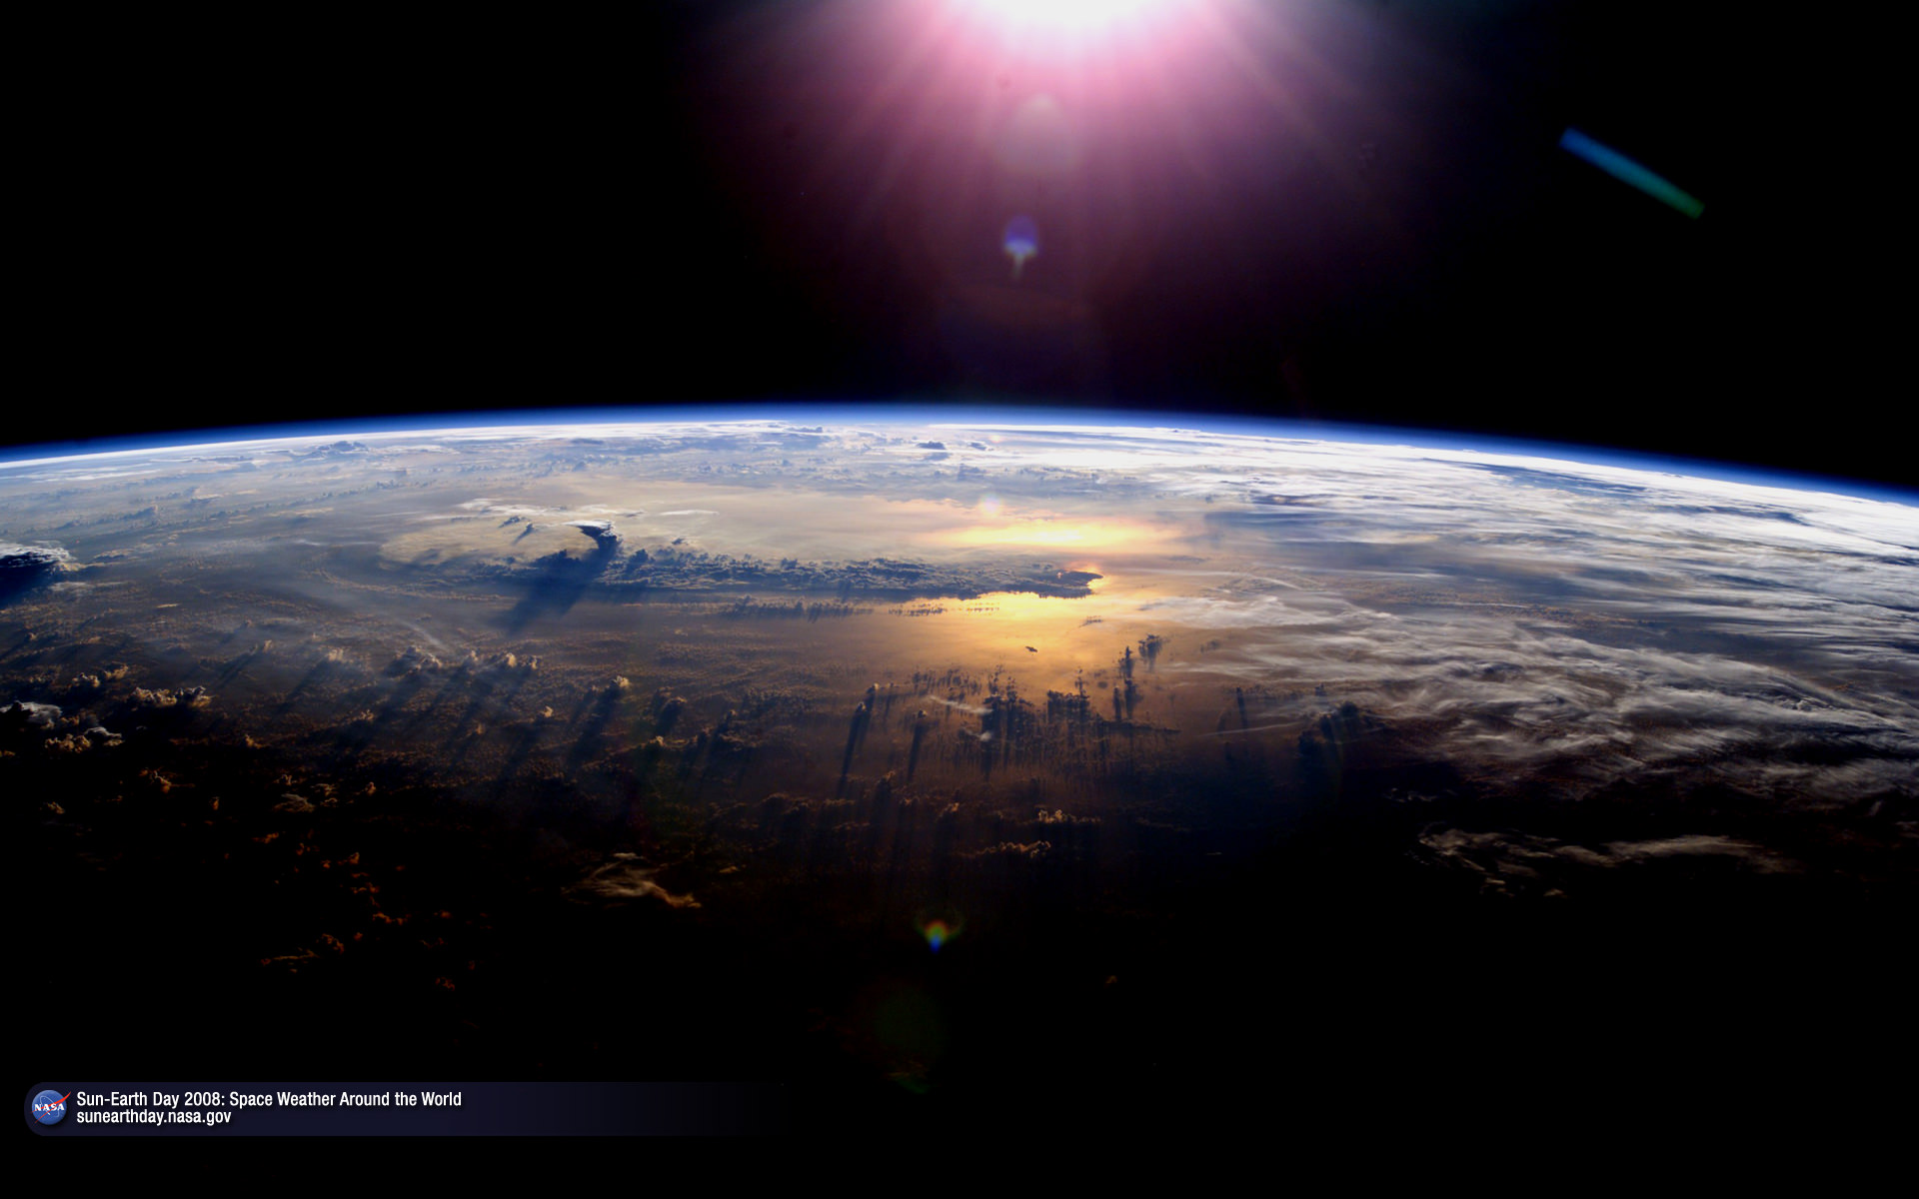



Pima Community College NASA Ascend 2021
Pima’s Team:
Quynn Bell, Michelle Burr, Pablo De La Fuente
Team Mentor:
AnnMarie Condes

Slide 2
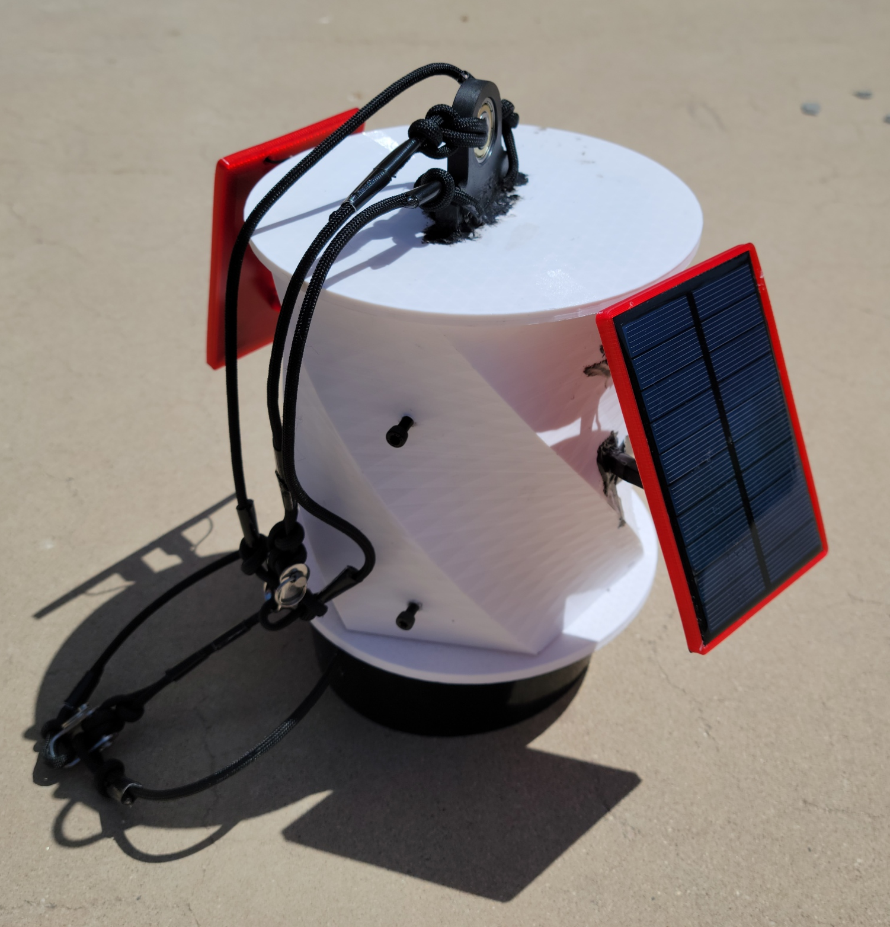
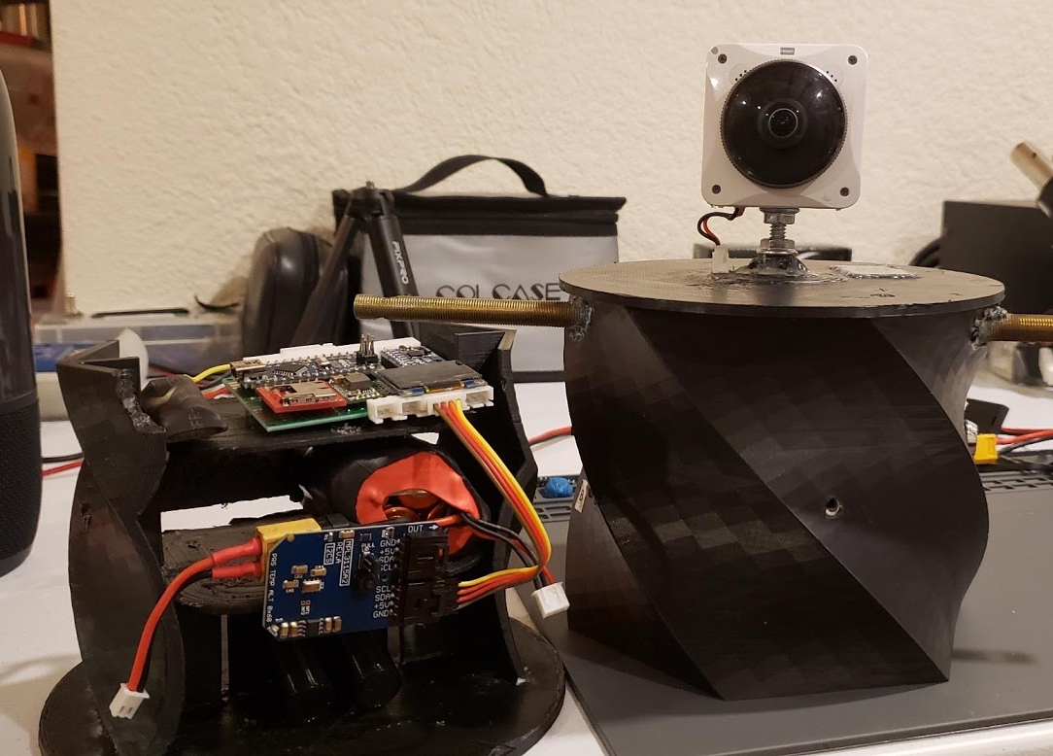
OBJECTIVES
Payload capable of measuring altitude, pressure, temperature, humidity, light intensity, acceleration, rotation, speed of sound, and radiation.
Conducting research to determine the effects of ionizing radiation on samples of Culex pipen, a species of mosquitoes.
Conducting upper atmospheric research in order to calculate the water vapor quality inside the payload.
Spring 2021 Payload
Fall 2020 Payload

Slide 3
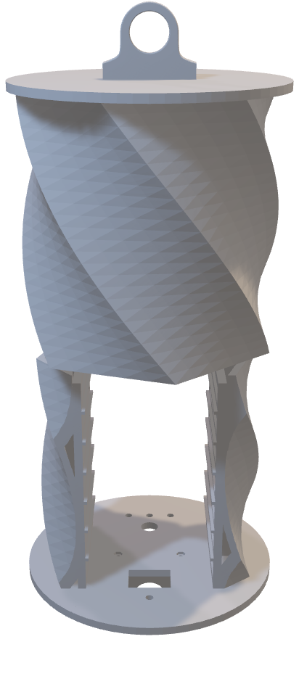
PAYLOAD DESIGN
One of the main focuses of our team this semester was centered around redesigning our payload capsule. We decided to implement an experimental mounting mechanism for attaching our payload to the balloon. Unfortunately, our payload capsule tore itself apart during flight and was lost with no recoverable data. Despite our loss, we learned valuable information regarding our choice of material and the limitations of 3D printed components.
Spring 2021 Payload 3D Model

Slide 4
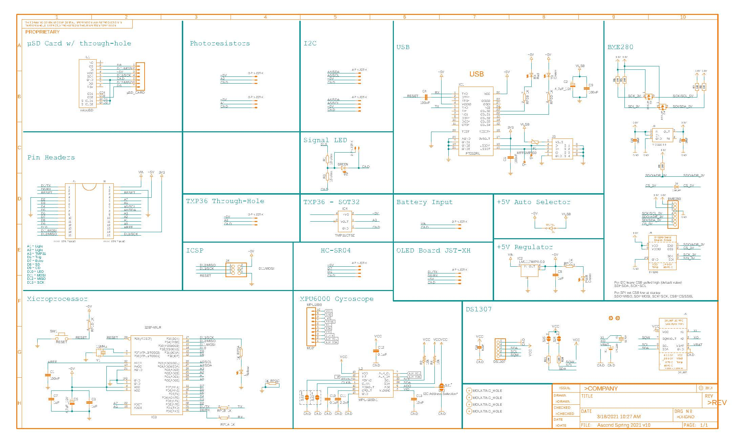
PAYLOAD ELECTRONICS
During this past year, our team has been redesigning the payload electronics to incorporate more sensors and log more accurate data. Issues surrounding our previous electronics include:
Time interval between readings is too long
Code is inefficient and slow
Low accuracy with certain sensors
Fusion360 schematic of our electronics equipment

Slide 5
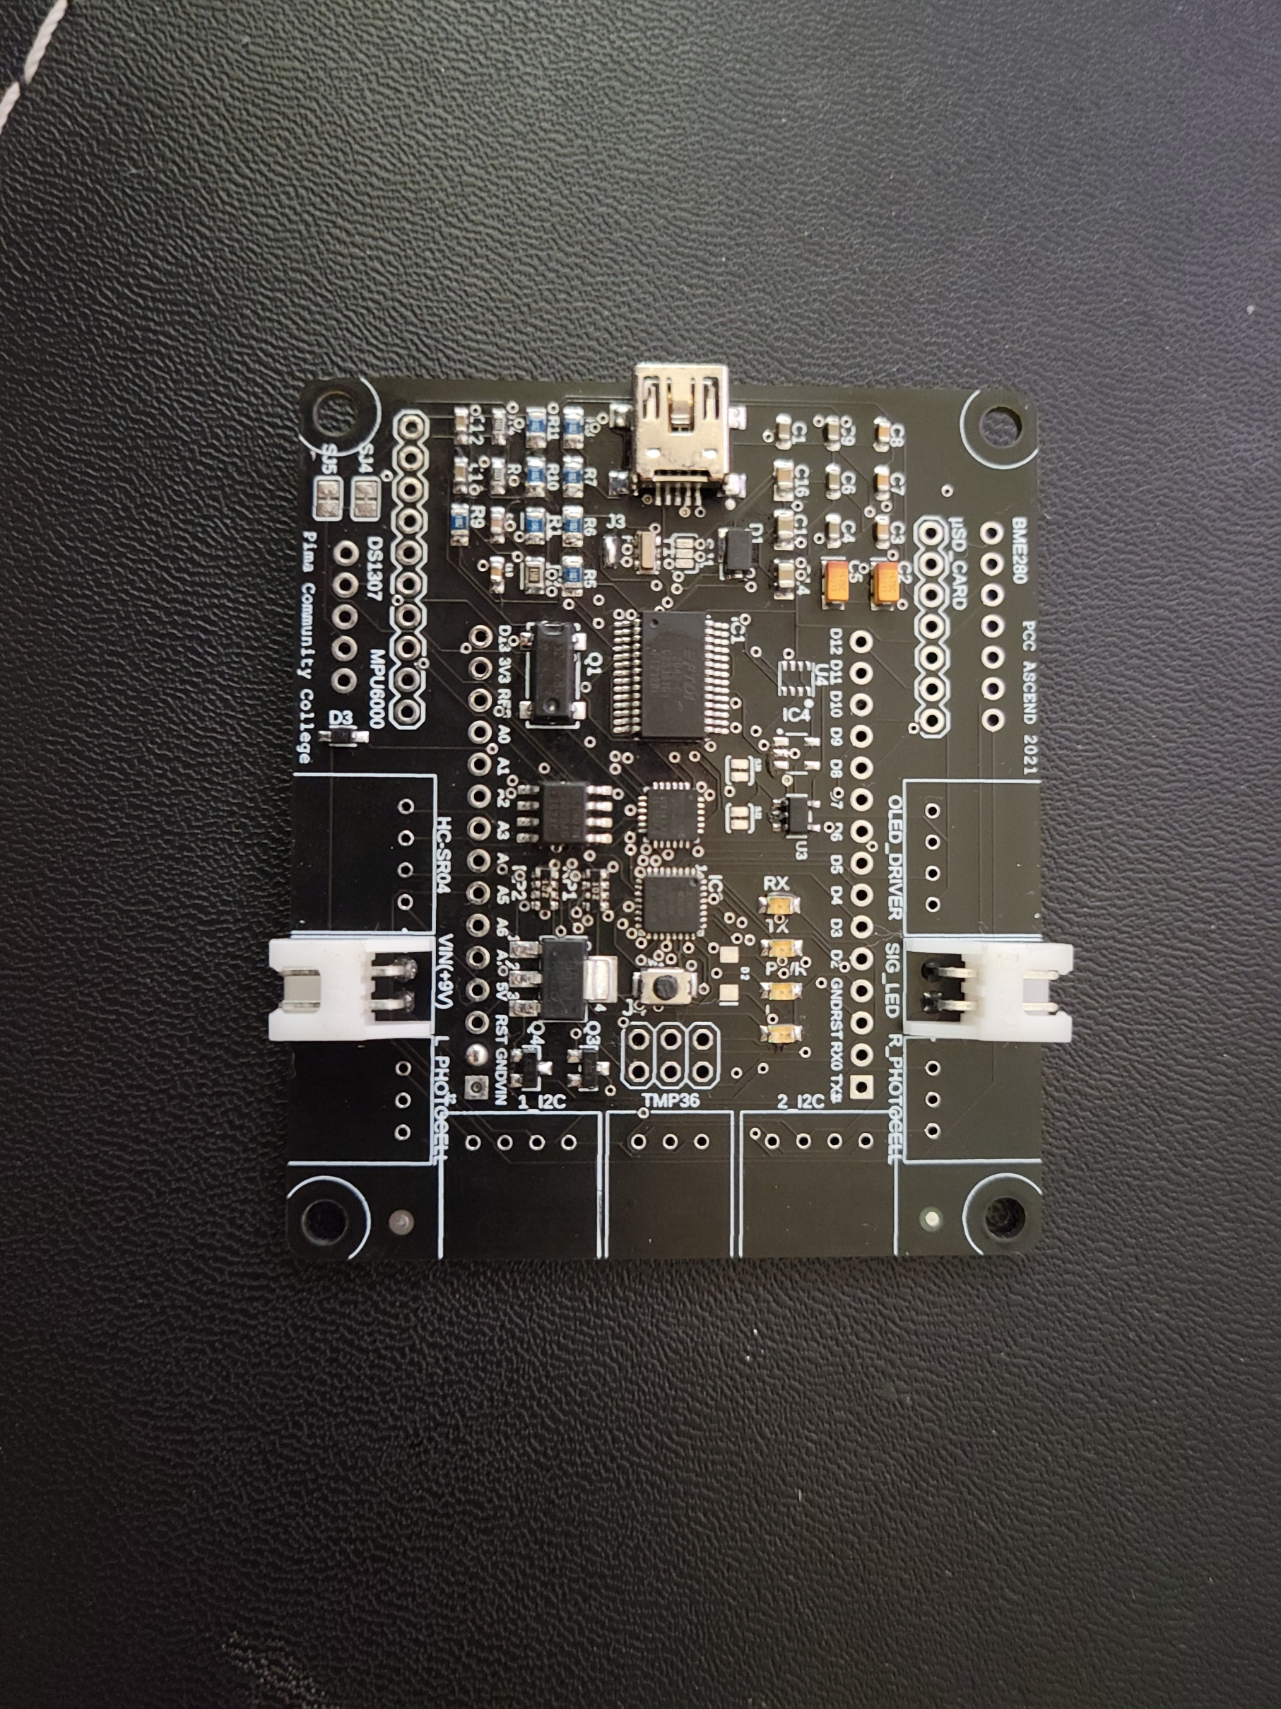
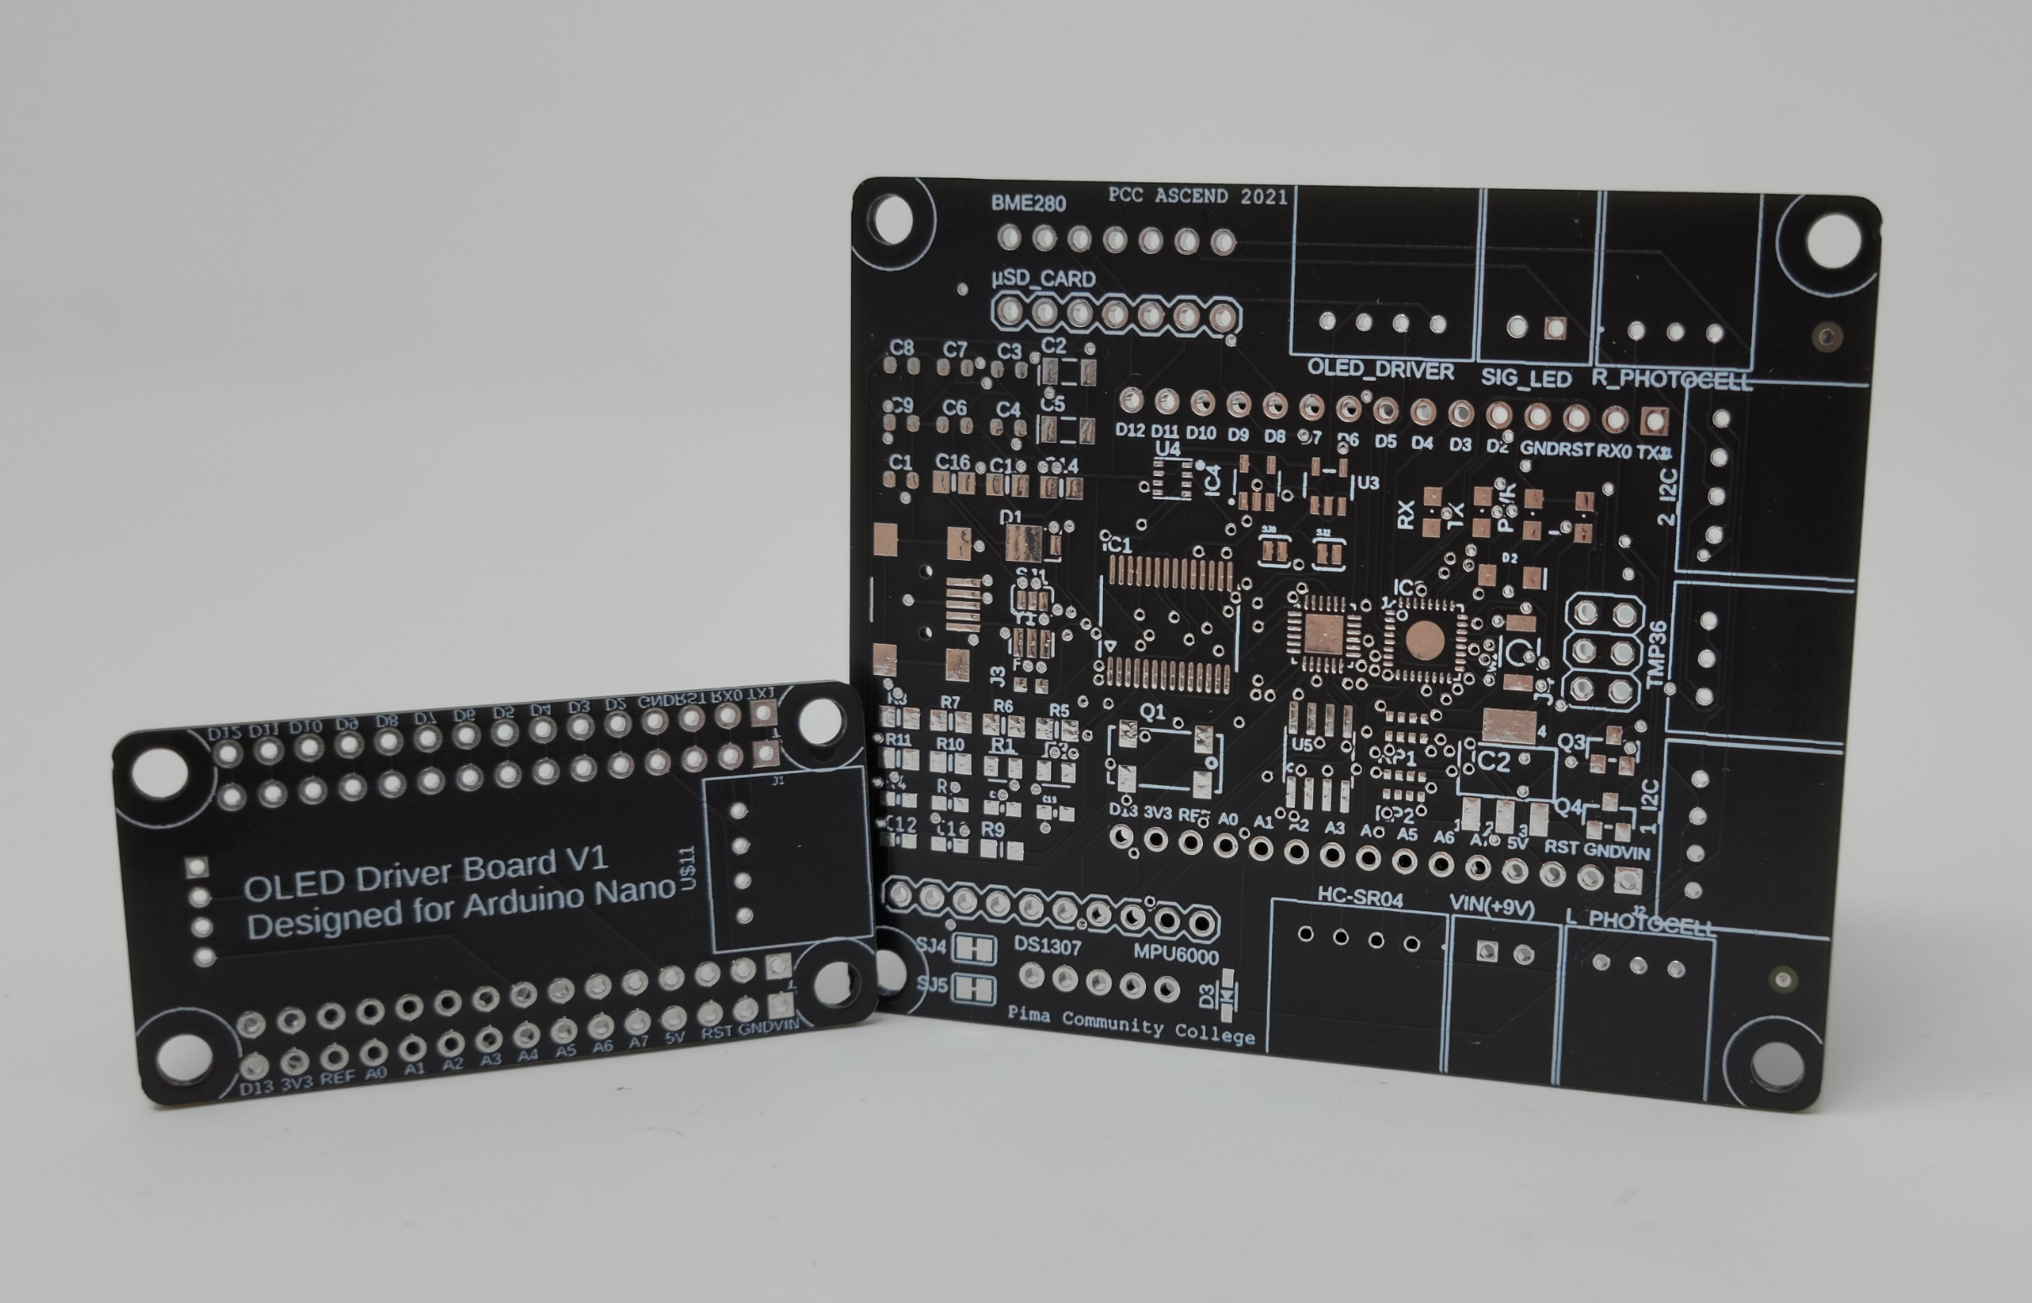
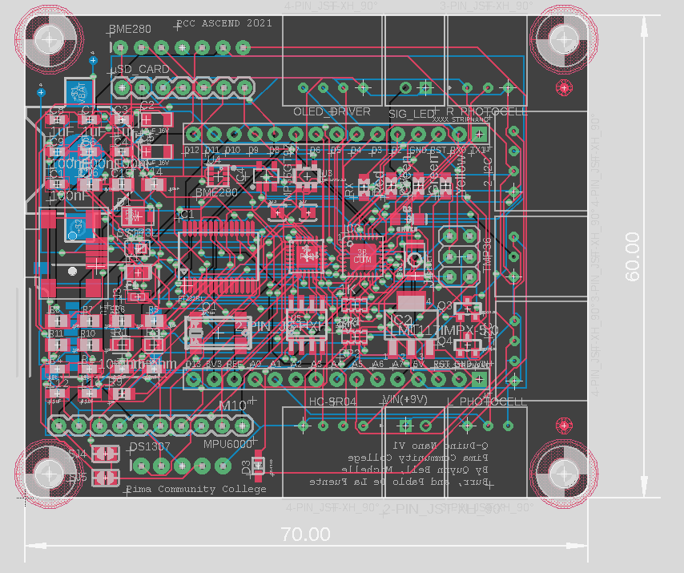
PAYLOAD ELECTONICS
This year our team wanted to design and manufacture multiple custom PCB’s with SMD IC components to read and log sensor data. Modeled after the Arduino Nano architecture, our custom PCB’s were intended to replace the electronics from the Fall 2020 semester, but unfortunately due to the time constraints, the boards were unable to be used. These were designed in Fusion360 and include a custom EAGLE component library.
Fully Soldered Custom PCB
Both PCB’s designed by our team
Mainboard Board Design

Slide 6
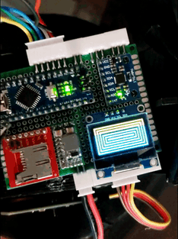
PAYLOAD ELECTONICS OVERVIEW
Since our team was unable to get the custom boards working for the Spring 2021 launch, we switched to our back-up plan and implemented the Fall 2020 electronics which were modified in order to accommodate the new sensors and code. The new equipment consists of:
BME280
Custom Geiger Counter
HC-SR04
Solar panels
New 18650 battery pack
Working Payload Electronics

Slide 7
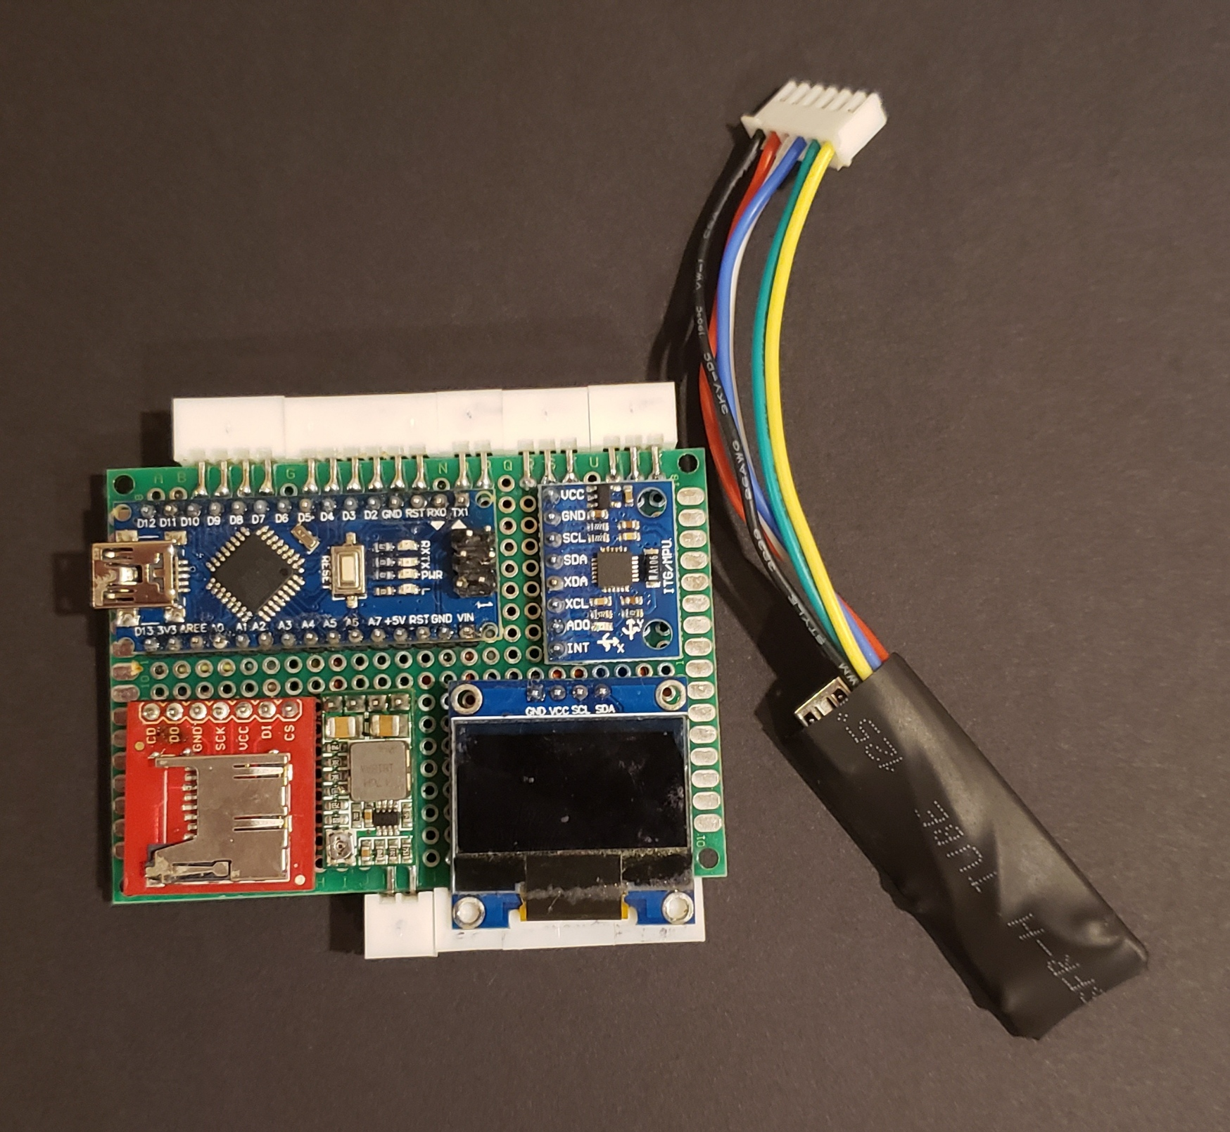
PAYLOAD ELECTONICS OVERVIEW
Our updated electronics parts list include:
2 Arduino Nanos (Serial Communication)
µSD Card Reader
OLED Screen (128x64 pixels)
GY-512 Gyro / Accelerometer
BME280 Alt, Temp, Pressure & Humidity Sensor
TMP36 Temperature Sensor (Analog Sensor)
HC-SR04 Ultrasonic Distance Sensor
Geiger Counter Module
2 Photoresistors
Signal LED
Voltage Regulator
3s 18650 Battery Pack
5*
10*
6*
9*
1
4
11
3
2
1
12*
7*
9*
* = External Device

Slide 8
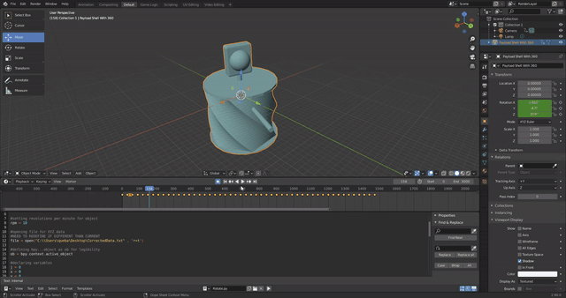
PAYLOAD ELECTRONICS DATA ANALYSIS
After the payload returns to earth and the data is analyzed, our team will make graphs of our data as well as a 3D animation using the gyroscope’s data. Using Blender and some custom python scripts, we will be able to make an animation that syncs up perfectly with the real flight.
Testing previous semester’s Blender animation python scripts

Slide 9
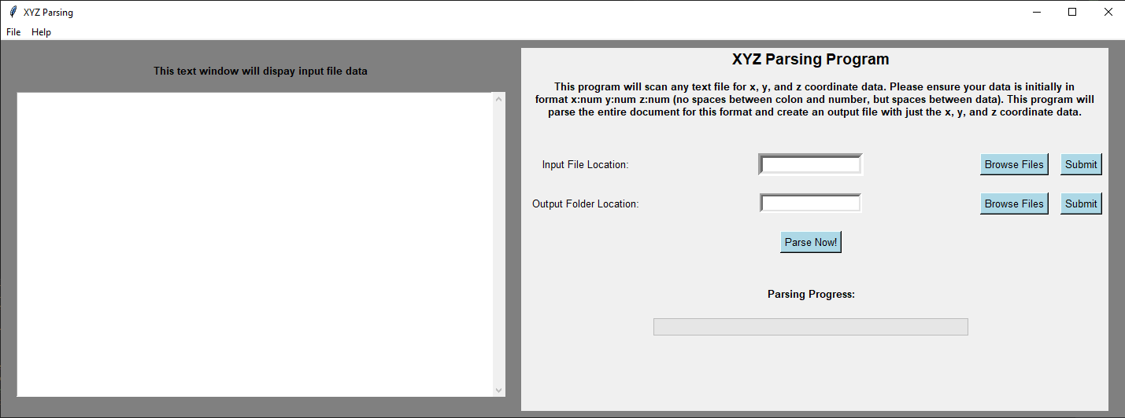
PAYLOAD ELECTRONICS DATA ANALYSIS
In order to get our data in the correct format, a separate python program had to be written. This program goes through the entire txt file and parses out the gyroscope data. The output file from this program is what is read by Blender.
Python based program with user interface

Slide 10
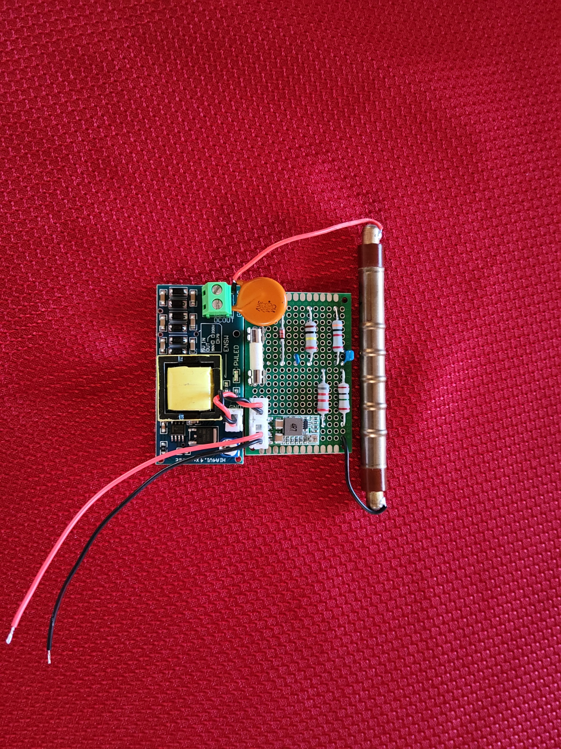
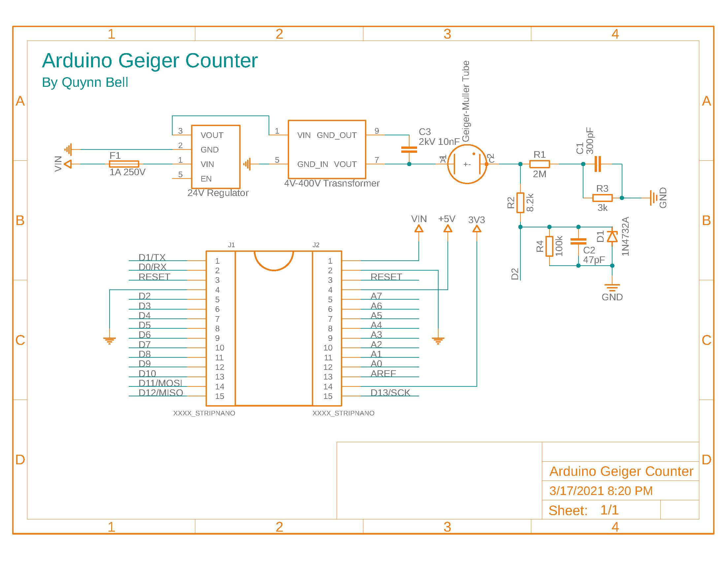
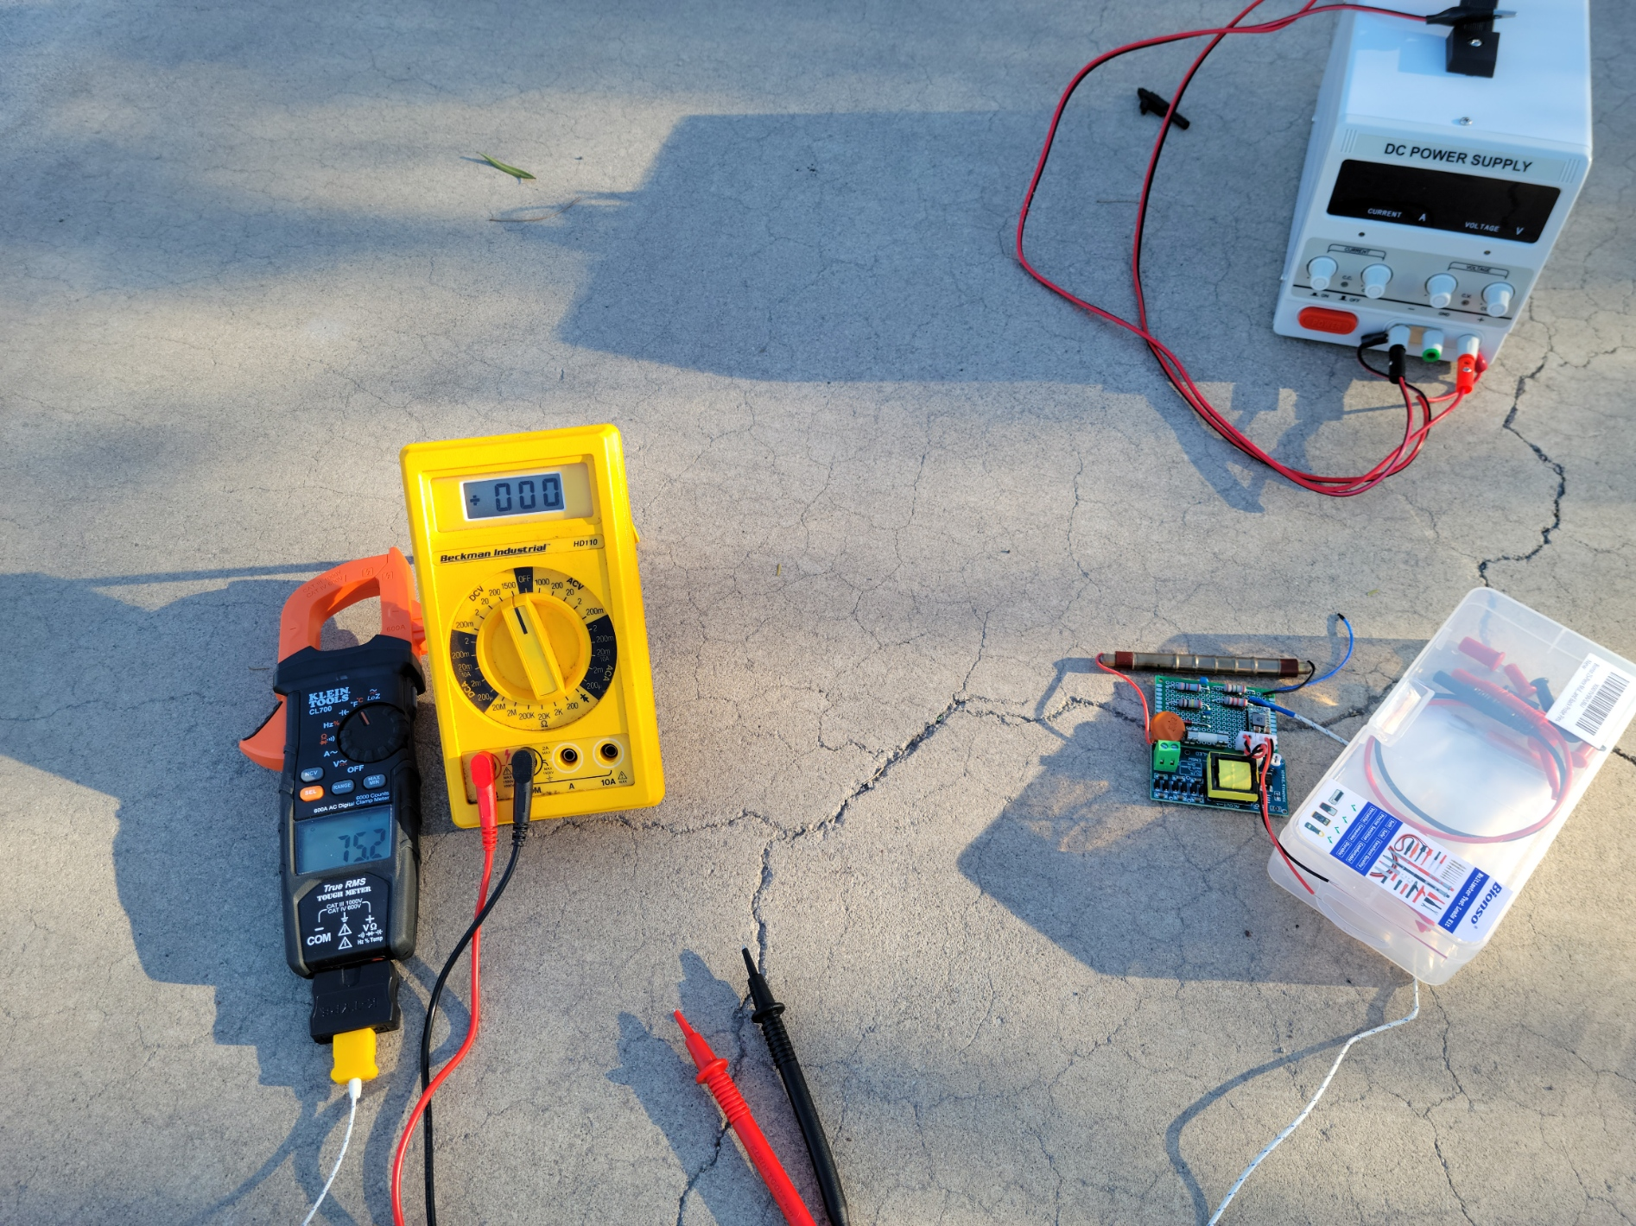
GEIGER COUNTER MODULE
Geiger-Muller Tube
In order to get accurate readings for radiation, our team set about designing and implementing a Geiger Counter into the payload.
High-Voltage Transformer
Working Geiger Counter
Fusion360 schematic of Geiger Counter Module
Initially testing outdoors

Slide 11
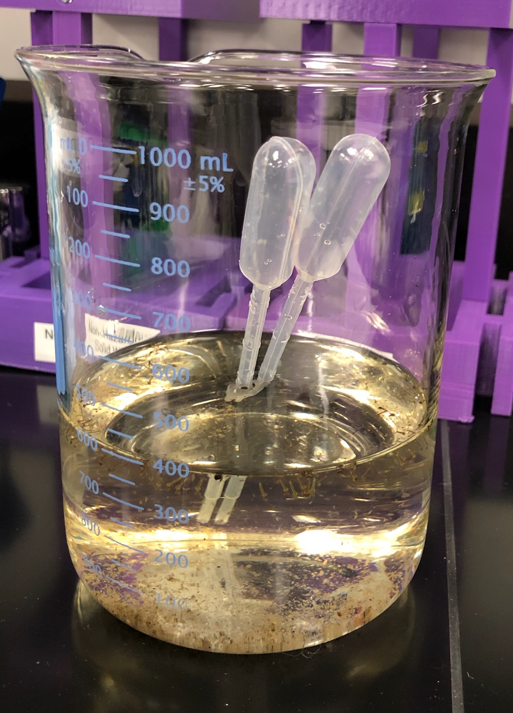
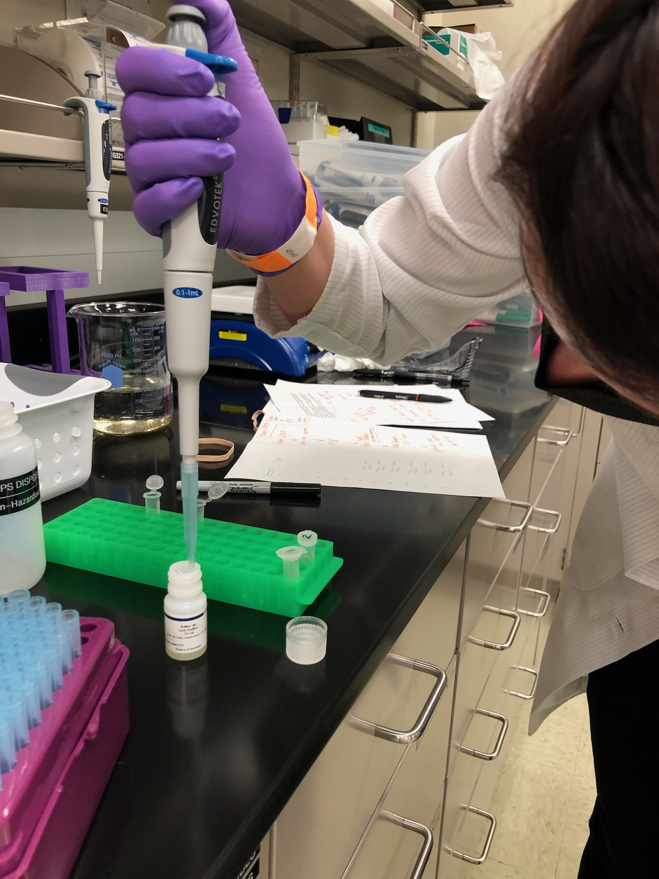
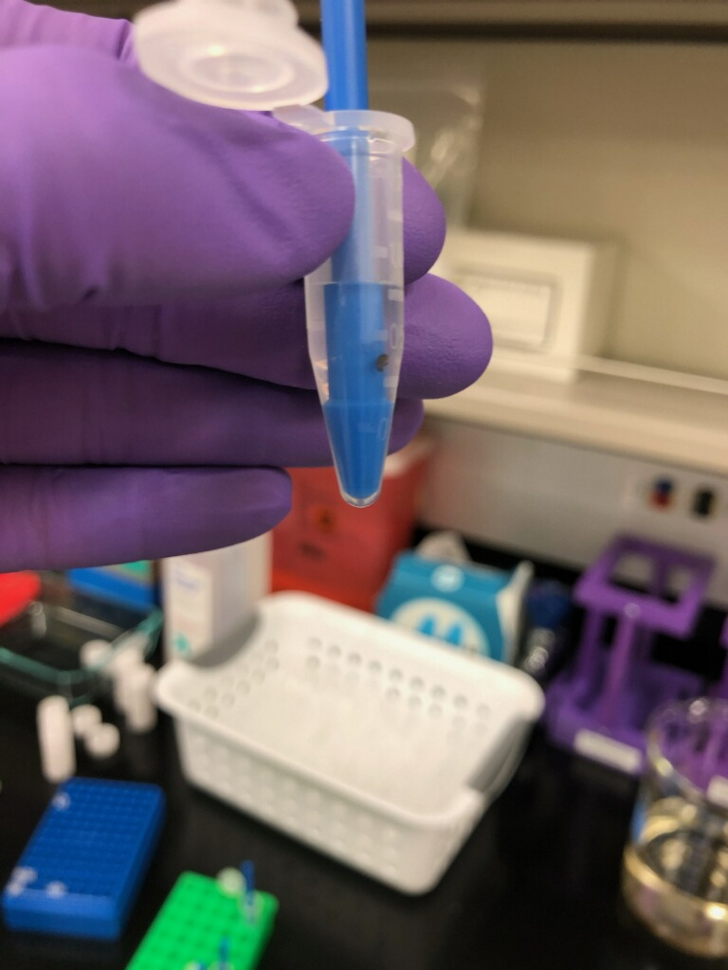
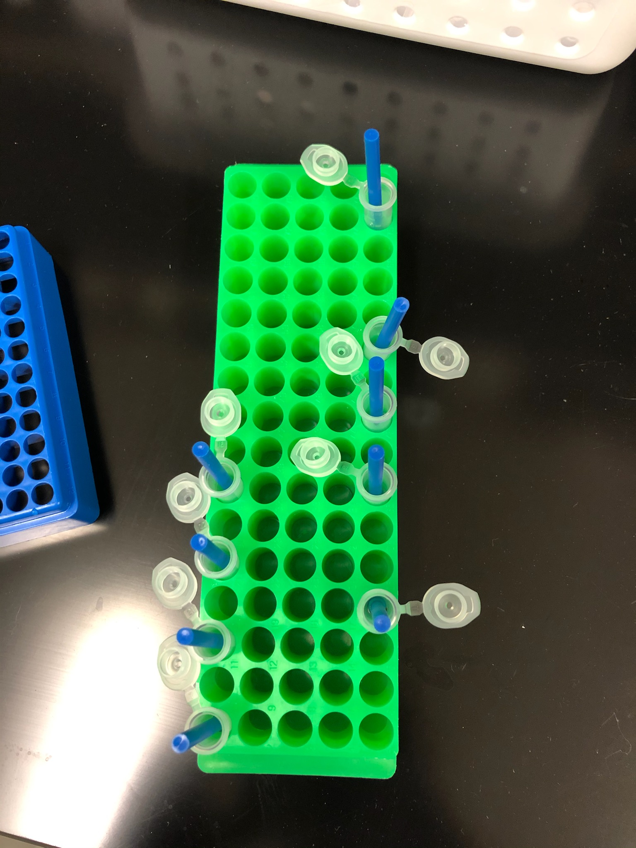
MOSQUITO STUDY OVERVIEW
I am currently studying the effects of ionizing radiation on the species Culex pipens. The objective of this project is to observe the direct damage pertaining to the mosquito’s DNA after being introduced to ionizing radiation while in flight. I hope to examine an increased DNA fragmentation, clustered DNA damage, single-stranded breaks, base lesions within one or two helical turns of the DNA, and any other abnormalities viewable.
PCR will be completed on April 16th and results will be available April 17th.

Slide 12
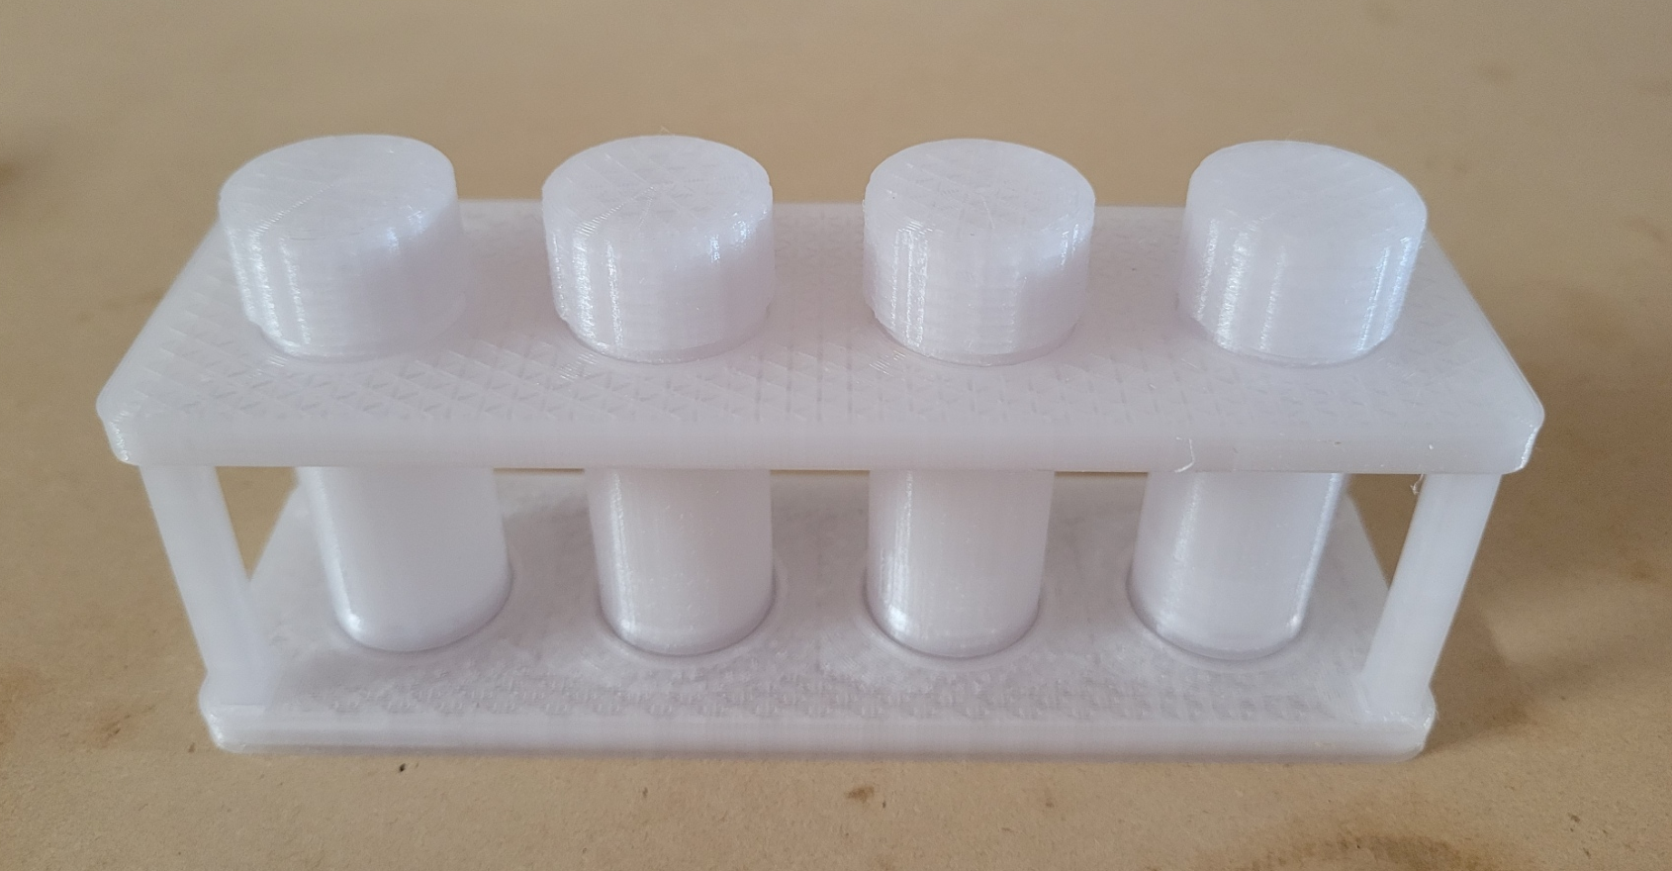
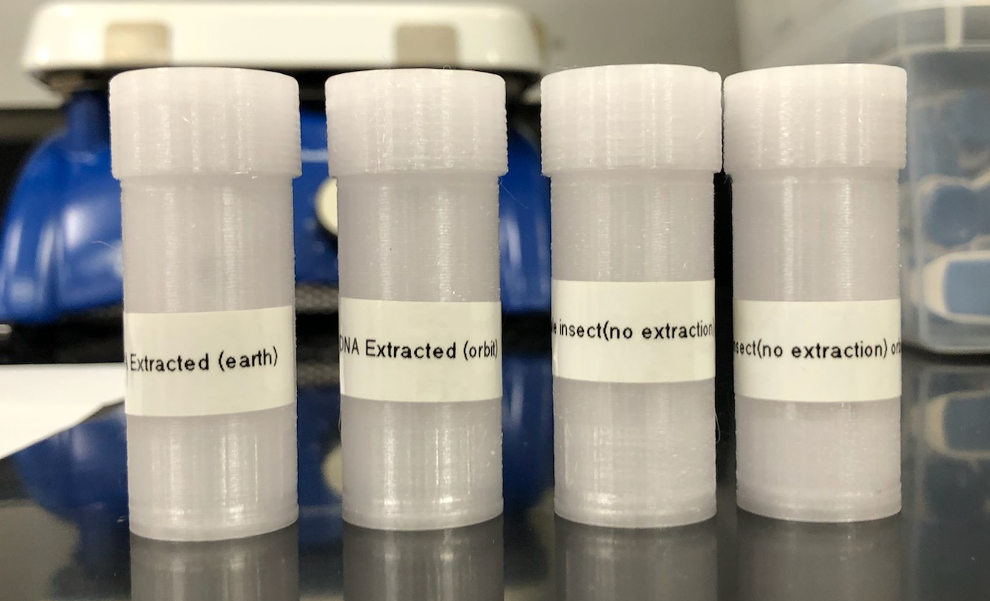
MOSQUITO STUDY DATA COLLECTION
The mosquitos will be onboard the payload for the duration of the flight. The mosquito’s DNA was isolated 24 hours pre-launch. There are four clear 3D-printed PETG test tubes in the payload. Each test tube contains four smaller PCR test tubes inside of it. The first two test tubes have four pupil-stage mosquitos in them, these are suspended in the fluid they are shipped in. One of the two test tubes will remain earthbound, while the other will go into orbit. The remaining two test tubes contain two mosquitos each in each tube. These two mosquitos have had all DNA extracted and placed in an AE Buffer (Tris-Cl & EDTA). I divided the 100 microliters of isolated DNA into two PCR test tubes. With the same concept of one tube going into orbit, and the other remaining earthbound. Keeping two of the tubes earthbound will ensure the control in this experiment. Post-launch I will use PCR, electrophoresis (with the aid of GelRed) and DNA sequencing to conclude results. There is also a Geiger counter on board to detect and measure the amount of ionizing radiation introduced throughout the flight. The measurements will also ensure the parameters of the data collected throughout the experiment.
3D Printed Test Tube Rack and Test Tubes
3D Printed Test Tubes Prepared for Flight

Slide 13
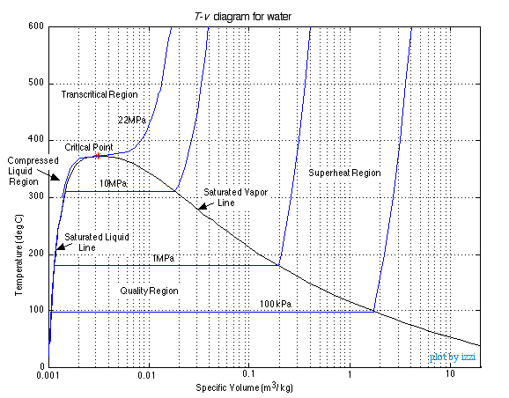
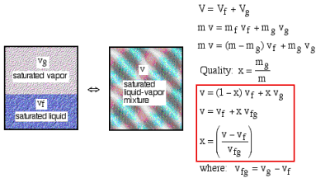
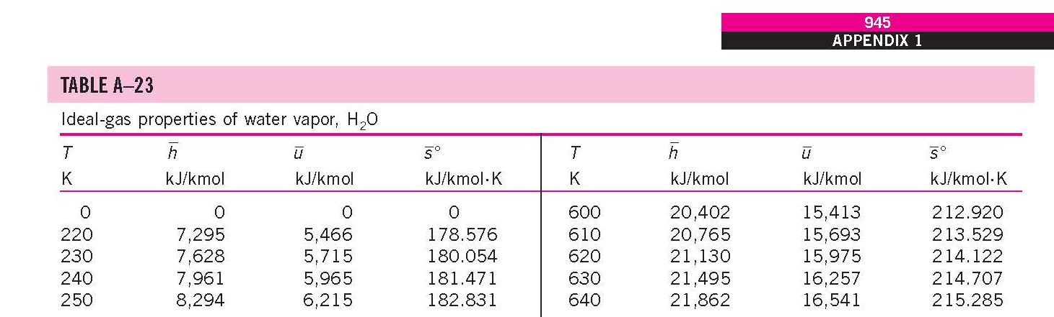

WATER VAPOR QUALITY STUDY
Our team is interested in studying how the upper atmosphere affects water vapor quality as well as the speed of sound. In order to collect and analyze this data we will compare our temperature, pressure, humidity and speed of sound data in order to generate graphs representing the water vapor pressure curve.

Slide 14
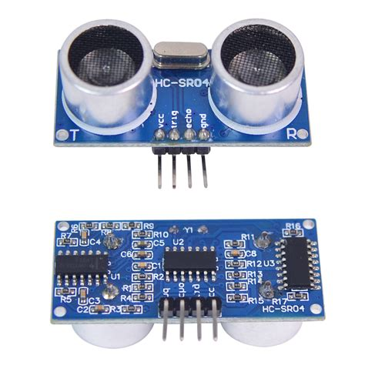
HC-SR04 ULTRASONIC DISTANCE SENSOR
Ultrasonic Transducers
The HC-SR04 is an ultrasonic distance sensor module capable of measuring distances of up to 4 meters with ±3mm accuracy. This sensor works by sending a distinct ultrasonic pulse out of one transducer while “listening” with the other and timing how long of a delay is between the transmitted and received signal. In our payload this sensor will be used to measure the speed of sound at a set distance of 10mm in order to calculate the water vapor quality inside the payload.
HC-SR04 Module

Slide 15

Special Thanks to: AnnMarie Condes Liz Dahlmann Michelle Coe Arizona Space Grant Consortium Arizona Near Space Research NASA

Slide 16
Thank You Any Questions Or Comments?

